Slide 1
Chapter 1- Introduction
CS 425 September 3, 2024
Ian Sommerville,
Software Engineering, 10th Edition
Pearson Education, Addison-Wesley
Note: These are a slightly modified version of Ch1 slides available from the author’s site http://iansommerville.com/software-engineering-book/
Chapter 1 Introduction

Slide 2
Topics covered
Professional software development
What is meant by software engineering
Software engineering ethics
A brief introduction to ethical issues that affect software engineering
Case studies
An introduction to three examples that are used in later chapters in the book
Chapter 1 Introduction

Slide 3
Software engineering
The economies of all developed nations are dependent on software
More and more systems are software controlled
Software engineering is concerned with theories, methods and tools for professional software development
Expenditure on software represents a significant fraction of GDP in all developed countries
Chapter 1 Introduction

Slide 4
Software costs
Software costs often dominate computer system costs. The costs of software on a PC are often greater than the hardware cost
Software costs more to maintain than it does to develop. For systems with a long life, maintenance costs may be several times development costs
Software engineering is concerned with cost-effective software development
Chapter 1 Introduction

Slide 5
Software project failure
Increasing system complexity
As new software engineering techniques help us to build larger, more complex systems, the demands change. Systems have to be built and delivered more quickly; larger, even more complex systems are required; systems have to have new capabilities that were previously thought to be impossible.
Failure to use software engineering methods
It is fairly easy to write computer programs without using software engineering methods and techniques. Many companies have drifted into software development as their products and services have evolved. They do not use software engineering methods in their everyday work. Consequently, their software is often more expensive and less reliable than it should be.
Chapter 1 Introduction

Slide 6
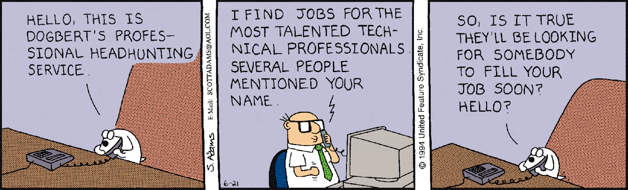
Professional software development
Chapter 1 Introduction

Slide 7
What is software?
Computer programs and associated documentation. Software products may be developed for a particular customer or may be developed for a general market.
Chapter 1 Introduction

Slide 8
What are the attributes of good software?
Good software should deliver the required functionality and performance to the user and should be maintainable, dependable and usable.
Chapter 1 Introduction

Slide 9
What is software engineering?
Software engineering is an engineering discipline that is concerned with all aspects of software production
Chapter 1 Introduction

Slide 10
What are the fundamental software engineering activities?
Software specification, software development, software validation and software evolution.
Chapter 1 Introduction

Slide 11
What is the difference between software engineering and computer science?
Computer science focuses on theory and fundamentals; software engineering is concerned with the practicalities of developing and delivering useful software.
Chapter 1 Introduction

Slide 12
What is the difference between software engineering and system engineering?
System engineering is concerned with all aspects of computer-based systems development including hardware, software and process engineering. Software engineering is part of this more general process
Chapter 1 Introduction

Slide 13
What are the key challenges facing software engineering?
Coping with increasing diversity, demands for reduced delivery times and developing trustworthy software.
Chapter 1 Introduction

Slide 14
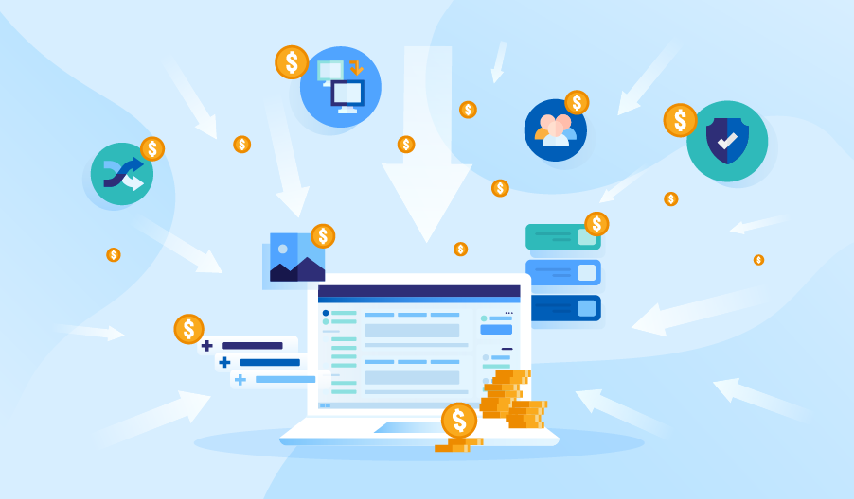
What are the costs of software engineering?
Roughly 60% of software costs are development costs, 40% are testing costs. For custom software, evolution costs often exceed development costs.
Chapter 1 Introduction

Slide 15
What are the best software engineering techniques and methods?
While all software projects have to be professionally managed and developed, different techniques are appropriate for different types of system. For example, games should always be developed using a series of prototypes whereas safety critical control systems require a complete and analysable specification to be developed. You can’t, therefore, say that one method is better than another.
Chapter 1 Introduction

Slide 16
What differences has the web made to software engineering?
The web has led to the availability of software services and the possibility of developing highly distributed service-based systems. Web-based systems development has led to important advances in programming languages and software reuse.
Chapter 1 Introduction

Slide 17
Software products
Generic products
Stand-alone systems that are marketed and sold to any customer who wishes to buy them
Examples – PC software such as graphics programs, project management tools; CAD software; software for specific markets such as appointments systems for dentists
Customized products
Software that is commissioned by a specific customer to meet their own needs
Examples – embedded control systems, air traffic control software, traffic monitoring systems
Chapter 1 Introduction

Slide 18
Product specification
Generic products
The specification of what the software should do is owned by the software developer and decisions on software change are made by the developer or software product owner.
Customized products
The specification of what the software should do is owned by the customer for the software and they make decisions on software changes that are required
Chapter 1 Introduction
Notes:
Products can be built with a generic product as a base and then customized to meet a user’s need. Examples would be ERP systems such as SAP.

Slide 19
Essential attributes of good software
Product characteristic | Description
Maintainability | Software should be written in such a way so that it can evolve to meet the changing needs of customers. This is a critical attribute because software change is an inevitable requirement of a changing business environment.
Dependability and security | Software dependability includes a range of characteristics including reliability, security and safety. Dependable software should not cause physical or economic damage in the event of system failure. Malicious users should not be able to access or damage the system.
Efficiency | Software should not make wasteful use of system resources such as memory and processor cycles. Efficiency therefore includes responsiveness, processing time, memory utilisation, etc.
Acceptability | Software must be acceptable to the type of users for which it is designed. This means that it must be understandable, usable and compatible with other systems that they use.
Chapter 1 Introduction

Slide 20
Software engineering
Software engineering is an engineering discipline that is concerned with all aspects of software production from the early stages of system specification through to maintaining the system after it has gone into use
Engineering discipline
Using appropriate theories and methods to solve problems bearing in mind organizational and financial constraints
All aspects of software production
Not just technical process of development. Also project management and the development of tools, methods, etc. to support software production
Chapter 1 Introduction
Notes:
All aspects of software production also include the requirements process, testing, etc.

Slide 21
Importance of software engineering
More and more, individuals and society rely on advanced software systems. We need to be able to produce reliable and trustworthy systems economically and quickly.
It is usually cheaper, in the long run, to use software engineering methods and techniques for software systems rather than just write the programs as if it was a personal programming project. For most types of system, the majority of costs are the costs of changing the software after it has gone into use.
Chapter 1 Introduction
Notes:
Costs from maintenance, changing business requirements, and found bugs. The more complicated your software becomes the more expensive it becomes to maintain.

Slide 22
Software process activities
Software specification, where customers, product managers, and engineers define the software that is to be produced and the constraints on its operation
Software development, where the software is designed and programmed
Software validation, where the software is checked to ensure that it is what the customer requires
Software evolution, where the software is modified to reflect changing customer and market requirements
Chapter 1 Introduction

Slide 23
Chapter 1 Introduction
Notes:
This is an image of a typical software development cycle. Software development cycles are usually customized for a particular organization. These are the standard phases for a typical SDLC

Slide 24
General issues that affect software
Heterogeneity
Increasingly, systems are required to operate as distributed systems across networks that include different types of computer and mobile devices
Business and social change
Business and society are changing incredibly quickly as emerging economies develop and new technologies become available. They need to be able to change their existing software and to rapidly develop new software.
Chapter 1 Introduction

Slide 25
General issues that affect software
Security and trust
As software is intertwined with all aspects of our lives, it is essential that we can trust that software
Scale
Software has to be developed across a very wide range of scales, from very small embedded systems in portable or wearable devices through to Internet-scale, cloud-based systems that serve a global community
Chapter 1 Introduction

Slide 26
Software engineering diversity
There are many different types of software system and there is no universal set of software techniques that is applicable to all of these
Unique by company or organization
The software engineering methods and tools used depend on the type of application being developed, the requirements of the customer and the background of the development team
Chapter 1 Introduction

Slide 27
Application types
Stand-alone applications
These are application systems that run on a local computer, such as a PC. They include all necessary functionality and do not need to be connected to a network.
Interactive transaction-based applications
Applications that execute on a remote computer and are accessed by users from their own PCs or terminals. These include web applications such as e-commerce applications.
Embedded control systems
These are software control systems that control and manage hardware devices. Numerically, there are probably more embedded systems than any other type of system.
Chapter 1 Introduction
Notes:
Cloud based services and software as a service SaaS, is part of interactive transaction-based applications.

Slide 28
Application types
Batch processing systems
These are business systems that are designed to process data in large batches. They process large numbers of individual inputs to create corresponding outputs.
Entertainment systems
These are systems that are primarily for personal use and which are intended to entertain the user.
Systems for modelling and simulation
These are systems that are developed by scientists and engineers to model physical processes or situations, which include many, separate, interacting objects
Chapter 1 Introduction
Notes:
Batch processing examples: Billing and payroll systems
Systems for modeling and simulation: This includes prototype software

Slide 29
Application types
Data collection systems
These are systems that collect data from their environment using a set of sensors and send that data to other systems for processing
Systems of systems
These are systems that are composed of a number of other software systems
Chapter 1 Introduction
Notes:
An example of an system of systems would be an ERP system

Slide 30
Software engineering fundamentals
Some fundamental principles apply to all types of software system, irrespective of the development techniques used:
Systems should be developed using a managed and understood development process. Of course, different processes are used for different types of software.
Dependability and performance are important for all types of system
Understanding and managing the software specification and requirements (what the software should do) are important
Where appropriate, you should reuse software that has already been developed rather than write new software
Chapter 1 Introduction
Notes:
Development processes are usually defined by the organization
Understanding the business purpose of software will understand the purpose of the software requirements

Slide 31
Internet software engineering
The Web is now a platform for running application and organizations are increasingly developing web-based systems rather than local systems
Web services (discussed in Chapter 19) allow application functionality to be accessed over the web
Cloud computing is an approach to the provision of computer services where applications run remotely on the ‘cloud’
Users do not buy software buy pay according to use
Chapter 1 Introduction
Notes:
Software as a Service (SaaS): a software licensing and delivery model in which software is licensed on a subscription basis and is centrally hosted. It is sometimes referred to as "on-demand software"

Slide 32
Web-based software engineering
Web-based systems are complex distributed systems but the fundamental principles of software engineering discussed previously are as applicable to them as they are to any other types of system
The fundamental ideas of software engineering apply to web-based software in the same way that they apply to other types of software system
Chapter 1 Introduction

Slide 33
Web software engineering
Software reuse
Software reuse is the dominant approach for constructing web-based systems. When building these systems, you think about how you can assemble them from pre-existing software components and systems.
Incremental and agile development
Web-based systems should be developed and delivered incrementally. It is now generally recognized that it is impractical to specify all the requirements for such systems in advance.
Chapter 1 Introduction

Slide 34
Web software engineering
Service-oriented systems
Software may be implemented using service-oriented software engineering, where the software components are stand-alone web services
Rich interfaces
Interface development technologies such as AJAX and HTML5 have emerged that support the creation of rich interfaces within a web browser
Chapter 1 Introduction

Slide 35
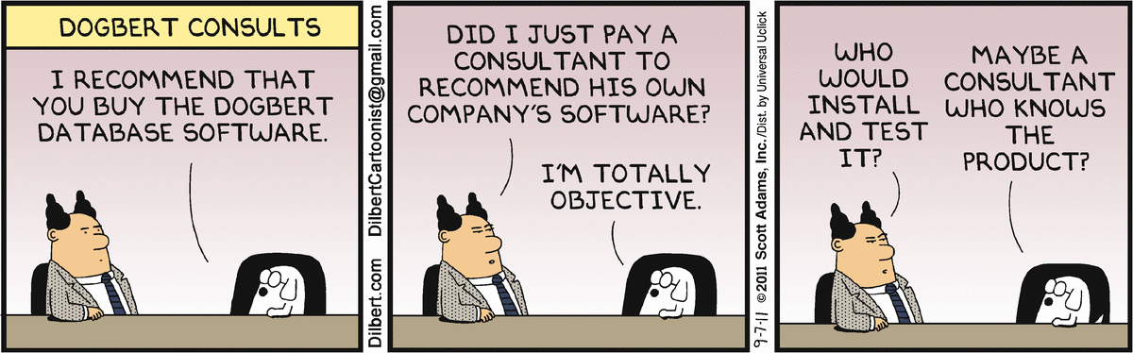
Software engineering ethics
Chapter 1 Introduction

Slide 36
Software engineering ethics
Software engineering involves wider responsibilities than simply the application of technical skills
Software engineers must behave in an honest and ethically responsible way if they are to be respected as professionals
Ethical behaviour is more than simply upholding the law but involves following a set of principles that are morally correct
Chapter 1 Introduction

Slide 37
Issues of professional responsibility
Confidentiality
Engineers should normally respect the confidentiality of their employers or clients irrespective of whether or not a formal confidentiality agreement has been signed
Competence
Engineers should not misrepresent their level of competence. They should not knowingly accept work which is outwith their competence.
Chapter 1 Introduction

Slide 38
Issues of professional responsibility
Intellectual property rights
Engineers should be aware of local laws governing the use of intellectual property such as patents, copyright, etc. They should be careful to ensure that the intellectual property of employers and clients is protected.
Computer misuse
Software engineers should not use their technical skills to misuse other people’s computers. Computer misuse ranges from relatively trivial (game playing on an employer’s machine, say) to extremely serious (dissemination of viruses).
Chapter 1 Introduction

Slide 39
ACM/IEEE Code of Ethics
The professional societies in the US have cooperated to produce a code of ethical practice
Members of these organisations sign up to the code of practice when they join
The Code contains eight Principles related to the behaviour of and decisions made by professional software engineers, including practitioners, educators, managers, supervisors and policy makers, as well as trainees and students of the profession
Chapter 1 Introduction

Slide 40
Rationale for the code of ethics
Computers have a central and growing role in commerce, industry, government, medicine, education, entertainment and society at large. Software engineers are those who contribute by direct participation or by teaching, to the analysis, specification, design, development, certification, maintenance and testing of software systems.
Because of their roles in developing software systems, software engineers have significant opportunities to do good or cause harm, to enable others to do good or cause harm, or to influence others to do good or cause harm. To ensure, as much as possible, that their efforts will be used for good, software engineers must commit themselves to making software engineering a beneficial and respected profession.
Chapter 1 Introduction

Slide 41
The ACM/IEEE Code of Ethics
Software Engineering Code of Ethics and Professional Practice
ACM/IEEE-CS Joint Task Force on Software Engineering Ethics and Professional Practices
PREAMBLE
The short version of the code summarizes aspirations at a high level of the abstraction; the clauses that are included in the full version give examples and details of how these aspirations change the way we act as software engineering professionals. Without the aspirations, the details can become legalistic and tedious; without the details, the aspirations can become high sounding but empty; together, the aspirations and the details form a cohesive code.
Software engineers shall commit themselves to making the analysis, specification, design, development, testing and maintenance of software a beneficial and respected profession. In accordance with their commitment to the health, safety and welfare of the public, software engineers shall adhere to the following Eight Principles:
Chapter 1 Introduction

Slide 42
Ethical principles
1. PUBLIC - Software engineers shall act consistently with the public interest.
2. CLIENT AND EMPLOYER - Software engineers shall act in a manner that is in the best interests of their client and employer consistent with the public interest.
3. PRODUCT - Software engineers shall ensure that their products and related modifications meet the highest professional standards possible.
4. JUDGMENT - Software engineers shall maintain integrity and independence in their professional judgment.
5. MANAGEMENT - Software engineering managers and leaders shall subscribe to and promote an ethical approach to the management of software development and maintenance.
6. PROFESSION - Software engineers shall advance the integrity and reputation of the profession consistent with the public interest.
7. COLLEAGUES - Software engineers shall be fair to and supportive of their colleagues.
8. SELF - Software engineers shall participate in lifelong learning regarding the practice of their profession and shall promote an ethical approach to the practice of the profession.
Chapter 1 Introduction

Slide 43
Ethical dilemmas
Disagreement in principle with the policies of senior management
Your employer acts in an unethical way and releases a safety-critical system without finishing the testing of the system
Participation in the development of military weapons systems or nuclear systems
Chapter 1 Introduction

Slide 44
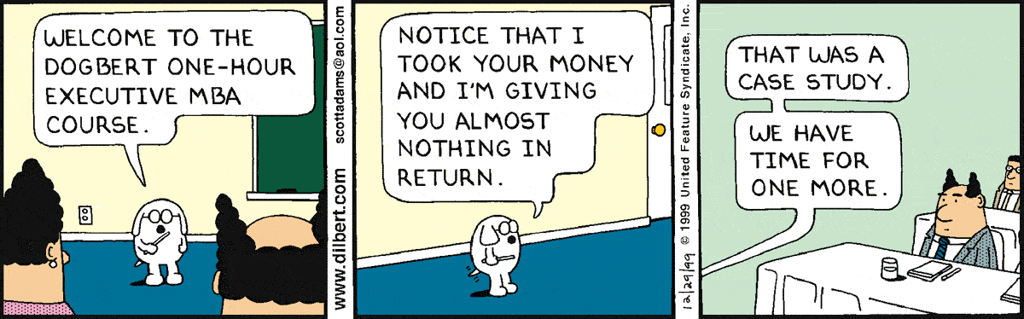
Case studies
Chapter 1 Introduction

Slide 45
Case studies
A personal insulin pump
An embedded system in an insulin pump used by diabetics to maintain blood glucose control
A mental health case patient management system
Mentcare. A system used to maintain records of people receiving care for mental health problems
A wilderness weather station
A data collection system that collects data about weather conditions in remote areas
iLearn: a digital learning environment
A system to support learning in schools
Chapter 1 Introduction

Slide 46
Insulin pump control system
Collects data from a blood sugar sensor and calculates the amount of insulin required to be injected
Calculation based on the rate of change of blood sugar levels
Sends signals to a micro-pump to deliver the correct dose of insulin
Safety-critical system as low blood sugars can lead to brain malfunctioning, coma and death; high-blood sugar levels have long-term consequences such as eye and kidney damage.
Chapter 1 Introduction

Slide 47
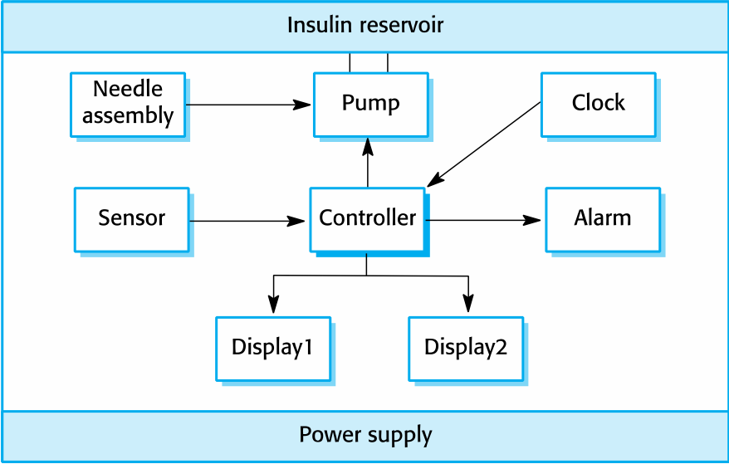
Insulin pump hardware architecture
Chapter 1 Introduction

Slide 48
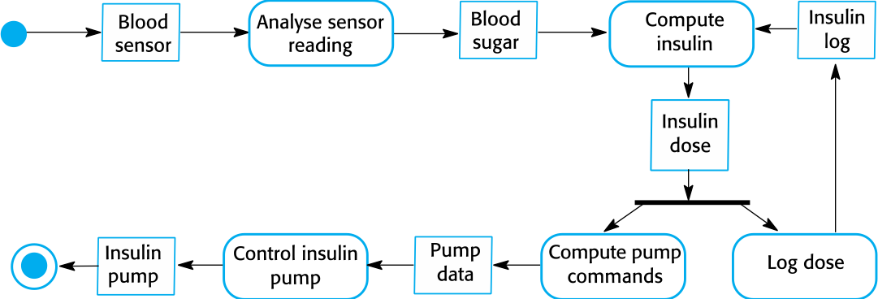
Activity model of the insulin pump
Chapter 1 Introduction

Slide 49
Essential high-level requirements
The system shall be available to deliver insulin when required
The system shall perform reliably and deliver the correct amount of insulin to counteract the current level of blood sugar
The system must therefore be designed and implemented to ensure that the system always meets these requirements
Chapter 1 Introduction

Slide 50
Mentcare: A patient information system for mental health care
A patient information system to support mental health care is a medical information system that maintains information about patients suffering from mental health problems and the treatments that they have received
Most mental health patients do not require dedicated hospital treatment but need to attend specialist clinics regularly where they can meet a doctor who has detailed knowledge of their problems
To make it easier for patients to attend, these clinics are not just run in hospitals. They may also be held in local medical practices or community centres.
Chapter 1 Introduction

Slide 51
Mentcare
Mentcare is an information system that is intended for use in clinics
It makes use of a centralized database of patient information but has also been designed to run on a PC, so that it may be accessed and used from sites that do not have secure network connectivity
When the local systems have secure network access, they use patient information in the database but they can download and use local copies of patient records when they are disconnected
Chapter 1 Introduction

Slide 52
Mentcare goals
To generate management information that allows health service managers to assess performance against local and government targets
To provide medical staff with timely information to support the treatment of patients
Chapter 1 Introduction

Slide 53
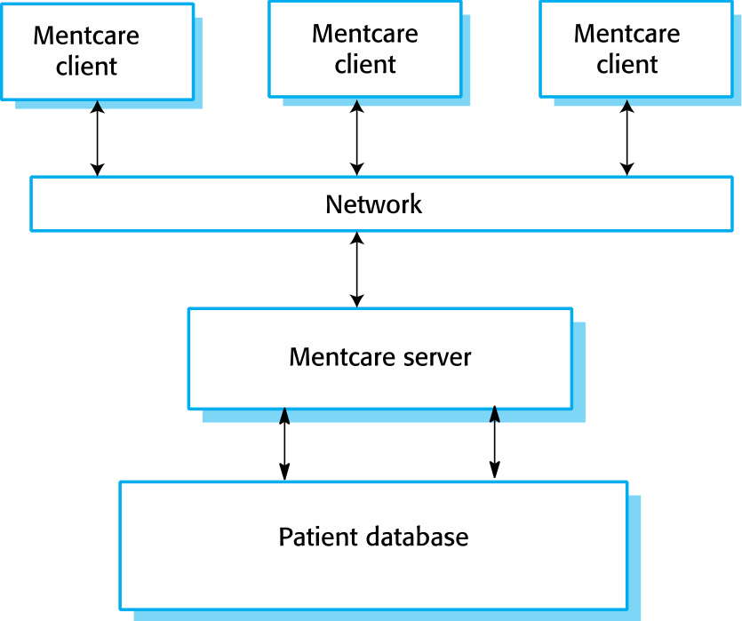
The organization of the Mentcare system
Chapter 1 Introduction

Slide 54
Key features of the Mentcare system
Individual care management
Clinicians can create records for patients, edit the information in the system, view patient history, etc. The system supports data summaries so that doctors can quickly learn about the key problems and treatments that have been prescribed.
Patient monitoring
The system monitors the records of patients that are involved in treatment and issues warnings if possible problems are detected.
Administrative reporting
The system generates monthly management reports showing the number of patients treated at each clinic, the number of patients who have entered and left the care system, number of patients sectioned, the drugs prescribed and their costs, etc.
Chapter 1 Introduction

Slide 55
Mentcare system concerns
Privacy
It is essential that patient information is confidential and is never disclosed to anyone apart from authorized medical staff and the patient themselves
Safety
Some mental illnesses cause patients to become suicidal or a danger to other people. Wherever possible, the system should warn medical staff about potentially suicidal or dangerous patients
The system must be available when needed otherwise safety may be compromised and it may be impossible to prescribe the correct medication to patients
Chapter 1 Introduction

Slide 56
Wilderness weather station
The government of a country with large areas of wilderness decides to deploy several hundred weather stations in remote areas
Weather stations collect data from a set of instruments that measure temperature and pressure, sunshine, rainfall, wind speed and wind direction.
The weather station includes a number of instruments that measure weather parameters such as the wind speed and direction, the ground and air temperatures, the barometric pressure and the rainfall over a 24-hour period. Each of these instruments is controlled by a software system that takes parameter readings periodically and manages the data collected from the instruments.
Chapter 1 Introduction

Slide 57
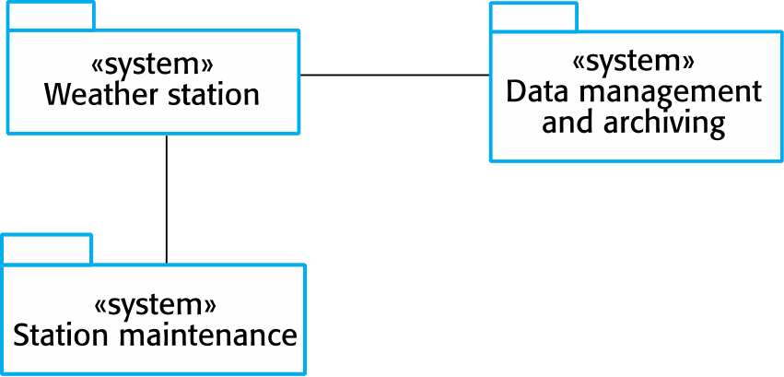
The weather station’s environment
Chapter 1 Introduction

Slide 58
Weather information system
The weather station system
This is responsible for collecting weather data, carrying out some initial data processing and transmitting it to the data management system
The data management and archiving system
This system collects the data from all of the wilderness weather stations, carries out data processing and analysis and archives the data.
The station maintenance system
This system can communicate by satellite with all wilderness weather stations to monitor the health of these systems and provide reports of problems
Chapter 1 Introduction

Slide 59
Additional software functionality
Monitor the instruments, power and communication hardware and report faults to the management system
Manage the system power, ensuring that batteries are charged whenever the environmental conditions permit but also that generators are shut down in potentially damaging weather conditions, such as high wind
Support dynamic reconfiguration where parts of the software are replaced with new versions and where backup instruments are switched into the system in the event of system failure
30/1/2014
Chapter 1 Introduction

Slide 60
iLearn: A digital learning environment
A digital learning environment is a framework in which a set of general-purpose and specially designed tools for learning may be embedded plus a set of applications that are geared to the needs of the learners using the system
The tools included in each version of the environment are chosen by teachers and learners to suit their specific needs
These can be general applications such as spreadsheets, learning management applications such as a Virtual Learning Environment (VLE) to manage homework submission and assessment, games and simulations
Chapter 1 Introduction

Slide 61
Service-oriented systems
The system is a service-oriented system with all system components considered to be a replaceable service
This allows the system to be updated incrementally as new services become available
It also makes it possible to rapidly configure the system to create versions of the environment for different groups such as very young children who cannot read, senior students, etc.
Chapter 1 Introduction

Slide 62
iLearn services
Utility services that provide basic application-independent functionality and which may be used by other services in the system
Application services that provide specific applications such as email, conferencing, photo sharing, etc. and access to specific educational content such as scientific films or historical resources
Configuration services that are used to adapt the environment with a specific set of application services and do define how services are shared between students, teachers and their parents
Chapter 1 Introduction

Slide 63
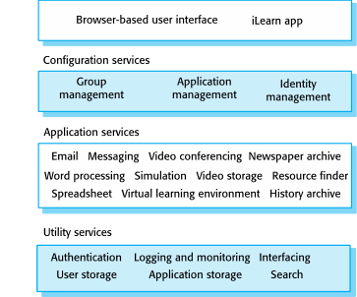
iLearn architecture
Chapter 1 Introduction

Slide 64
iLearn service integration
Integrated services are services which offer an API (application programming interface) and which can be accessed by other services through that API. Direct service-to-service communication is therefore possible.
Independent services are services which are simply accessed through a browser interface and which operate independently of other services. Information can only be shared with other services through explicit user actions such as copy and paste; re-authentication may be required for each independent service.
Chapter 1 Introduction

Slide 65
Key points
Software engineering is an engineering discipline that is concerned with all aspects of software production
Essential software product attributes are maintainability, dependability and security, efficiency & acceptability
The high-level activities of specification, development, validation & evolution are part of all software processes
The fundamental notions of software engineering are universally applicable to all types of system development
Chapter 1 Introduction

Slide 66
Key points
There are many different types of system and each requires appropriate software engineering tools and techniques for their development
The fundamental ideas of software engineering are applicable to all types of software system
Software engineers have responsibilities to the engineering profession and society. They should not simply be concerned with technical issues.
Professional societies publish codes of conduct which set out the standards of behaviour expected of their members
Chapter 1 Introduction

Slide 67
Professional Tip of the Day: Tips for Software Job Interviews
Know what the company does and the products they produce
Come up with a few questions to ask them about their company or products during the interview
Research potential interview questions
Know the salary range for the position you are applying for
Make sure you can speak about or at least have knowledge about the technologies listed in the job posting
Be honest if you don’t have experience or knowledge about a topic but be willing to learn or challenge yourself

